Slide 1
Dev CoP
Kafka Topic Design
TDD Experiments

Slide 2
Dev CoP
Kafka Topic Design
TDD Experiments

Slide 3
Keys and Partitions
Events Topic
7 | 1 | 11 | 42 | 16 | Part 0
 |  | 5 | 2 | 23 | Part 1
 | 3 | 3 | 64 | 35 | Part 2
7 | 1 | 1 | 4 | 1 | Part 0
 |  | 5 | 2 | 2 | Part 1
 | 3 | 3 | 6 | 3 | Part 2
7 | 1 | 1 | 4 | 1 | Part 0
 |  | 5 | 2 | 2 | Part 1
 | 3 | 3 | 6 | 3 | Part 2
Keys shown, not values or offsets
Hash(n) = n % 3

Slide 4
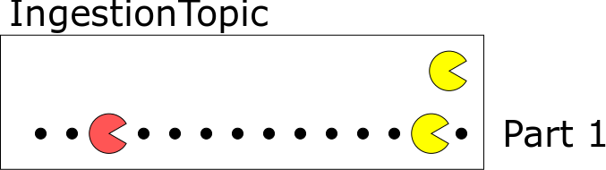
One Partition

Slide 5
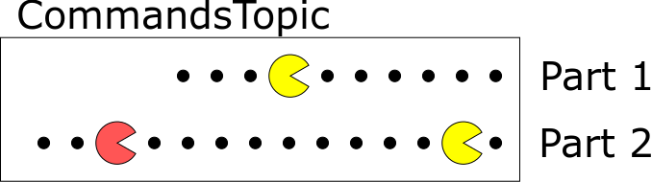
Two Partitions

Slide 6
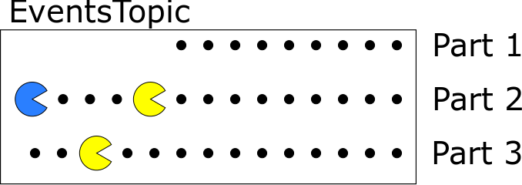
Three Partitions

Slide 7
Dev CoP
Kafka Topic Design
Questions?
TDD Experiments

Slide 8
Dev CoP
Kafka Topic Design
TDD Experiments

